Slide 1

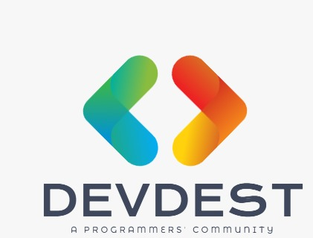
A Minor Project Presentation for the project :
This project is completely developed by team semicolon under the guidance of Prof. Divya Kumari. The members of the team are:
Devansh Kashyap 1706036
Harsh Singh 1706038
Himanshu 1706040

Slide 2
Introduction
DevDest is a developer/programmer questionnaire application for an android platform where developers across the world can ask questions related to technical stuff. Personalised experience to each user is guaranteed through highly efficient algorithms and data security is at its best.

Slide 3


IDEA behind creation
Seeing the extent of knowledge required in solving technical problems in today’s world, developers around the world needed a common destination to clear their doubts, have open knowledge and share their ideas about solving a problem with everyone.
This is the main idea behind the creation of DevDest Application where multiple users from different locations can access the answers and questions of other developers.

Slide 4
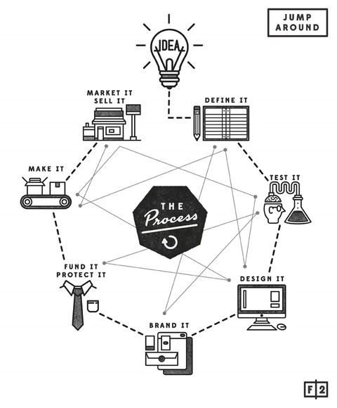
WORKFLOW

Slide 5
Login Activity
Login or Signup for an account
Login Backend
Request made to the AWS server to get access to database.
Return Intent
Intent fired to get access to the user’s account.
Input gets an email id and a password.

Slide 6
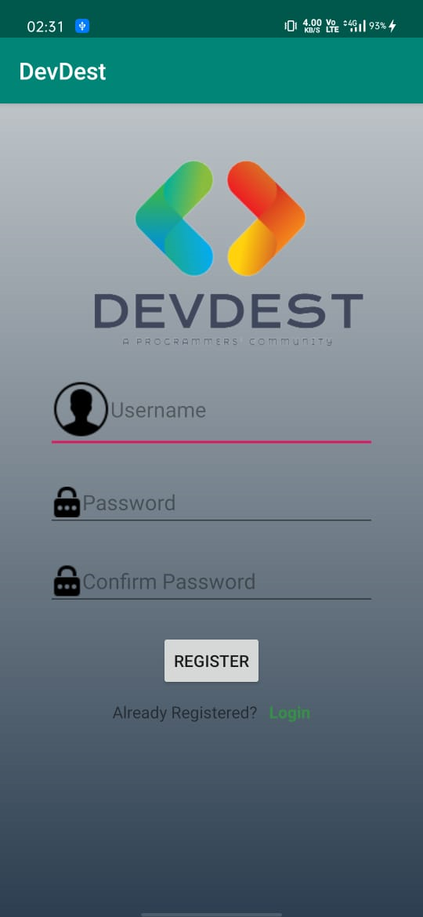
The Login Intent

Slide 7
Posting Queries
Post a new query
Processing Backend
The query is posted to the main database where machine learning algorithm processes the question and classifies it into different tags.
Return Intent
Users with tag preferences already provided in their accounts receive an opportunity to answer the queries.
Input gets a question or doubt in normal human language.

Slide 8
Post a new query
The user inputs a new question as input.
Query classified into tags.
At the backend side of the AWS server, ML algorithm does the work
Query sent to interested developers
The users have their own preferences and get a chance to answer the queries.
The end user gets the answers and discussion with other developers on the application.

Slide 9
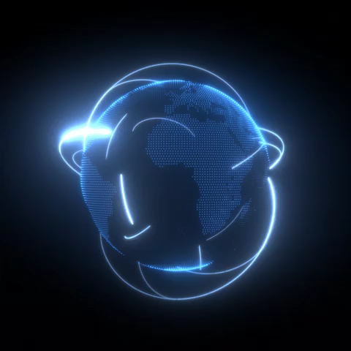
Technology used
Android
Python
Machine learning with Python
Dialogflow
Cloud integration
Amazon Web Service

Slide 10

UML DIAGRAMS
A UML diagram is a diagram based on the UML (Unified Modeling Language) with the purpose of visually representing a system along with its main actors, roles, actions, artifacts or classes, in order to better understand, alter, maintain, or document information about the system.

Slide 11
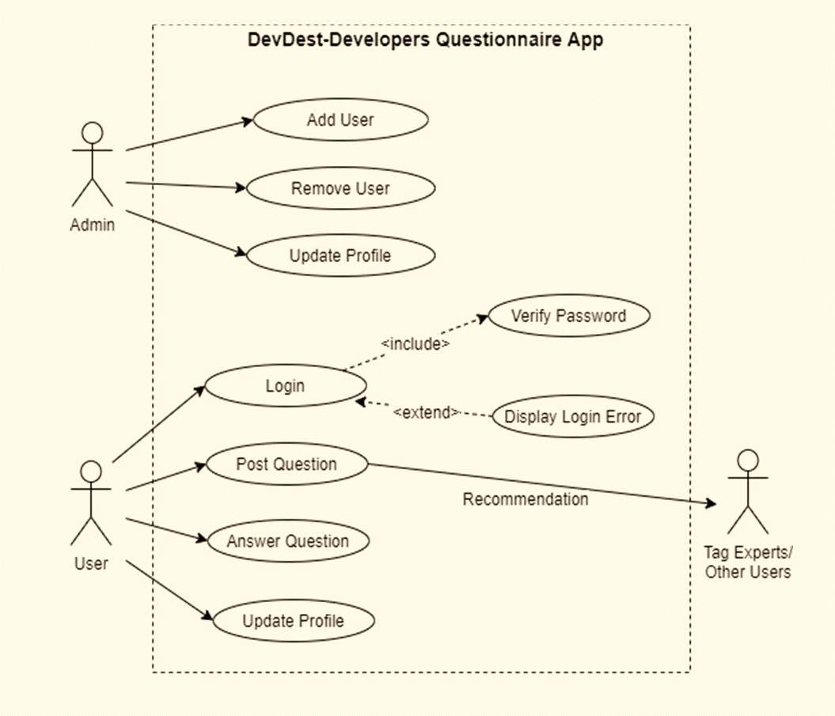
Use Case Diagram
A use case diagram at its simplest is a representation of a user's interaction with the system that shows the relationship between the user and the different use cases in which the user is involved.

Slide 12
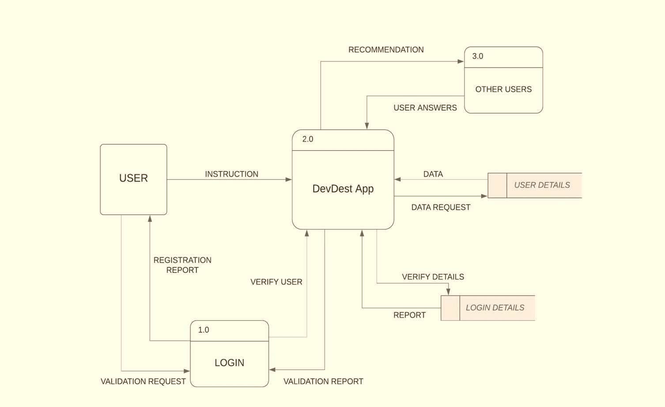
Data Flow Diagram
A data-flow diagram is a way of representing a flow of data through a process or a system. The DFD also provides information about the outputs and inputs of each entity and the process itself.

Slide 13
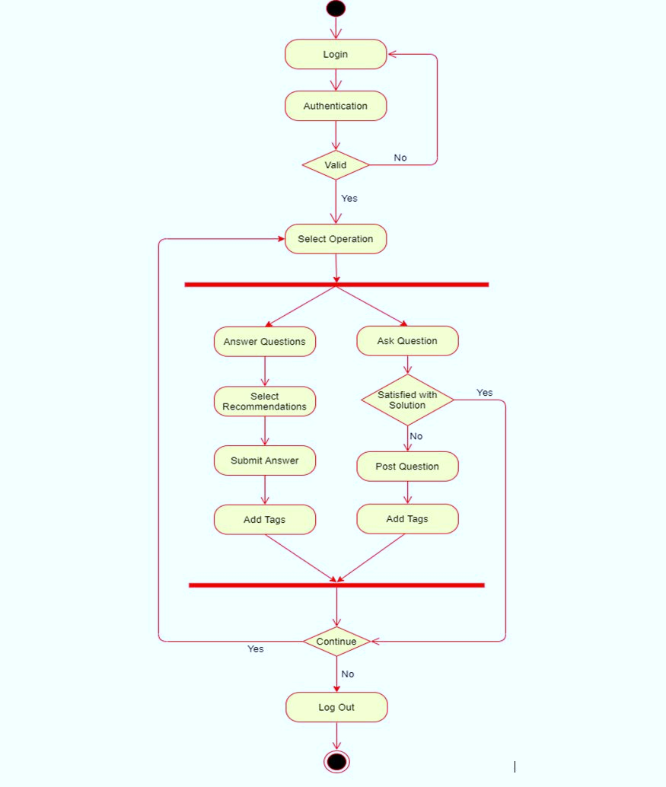
Activity Diagram
Activity diagrams are graphical representations of workflows of stepwise activities and actions with support for choice, iteration and concurrency.

Slide 14
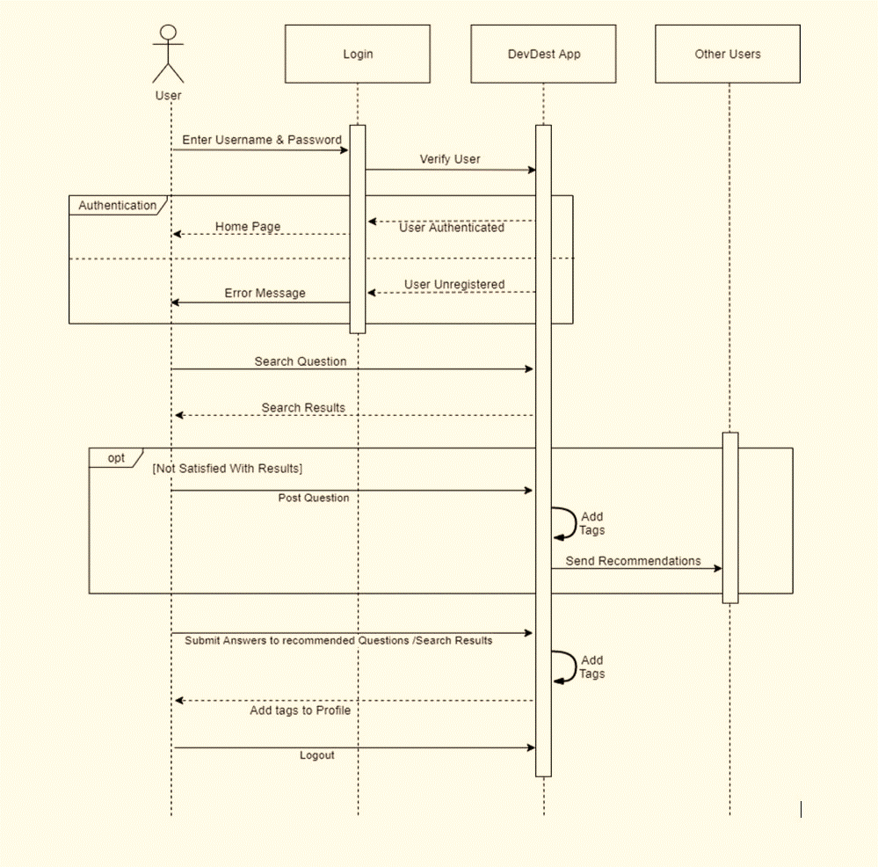
Sequence Diagram
A sequence diagram shows object interactions arranged in time sequence. It depicts the objects and classes involved in the scenario and the sequence of messages exchanged between the objects needed to carry out the functionality of the scenario.

Slide 15
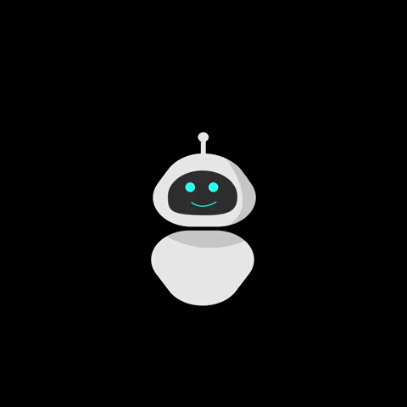
The DevDest chat bot
This application also has a chat bot made using NLP as a help and support bot for the basic queries of the users of the application. The chat bot is web and telegram integrated which can handle basic queries on the working of the application and can handle small talks too to reply like a friend to the user.

Slide 16
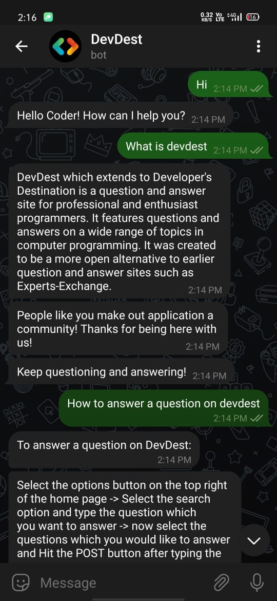
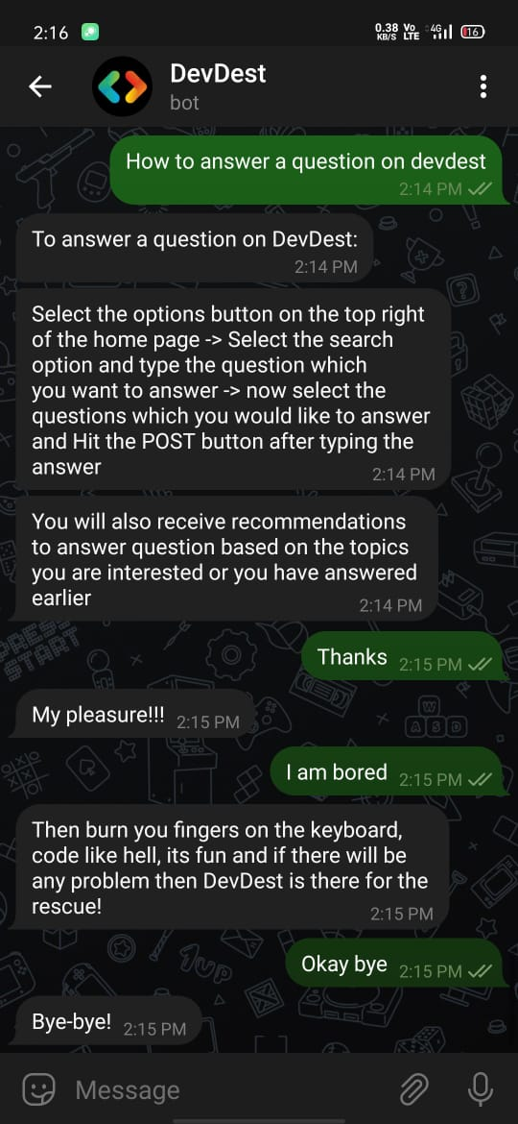
Live Screenshots of chat with DevDest Chat Bot

Slide 17

CONCLUSION
With the continued evolution in technology, the need for a common destination for the developer community is becoming more and more essential now-a-days, where developers can freely access the designs, codes, algorithms, and ideas of other developers from around the world. This is the basic idea behind the DevDest application, which is a platform for developers to discuss their issues that they are facing, share their designs and advanced ideas, as well as creating a community which brings developers together and facilitates development and improvement. DevDest helps developers find the accurate answers to the questions precisely and dedicatedly, and also gives a personal account for each and every user. By the use of Natural Language processing, which is a growing technology in today’s world, DevDest manages different queries and answers and classifies them into respective tags. The design of this application is very simple and user-friendly, along with a great efficiency. DevDest also provides a chatbot where developers can easily navigate through the application and solves some basic issues. Thus, we can say that DevDest has a great scope in future for the developers to find the solution to their questions and update themselves to latest technologies under one umbrella.

Slide 18
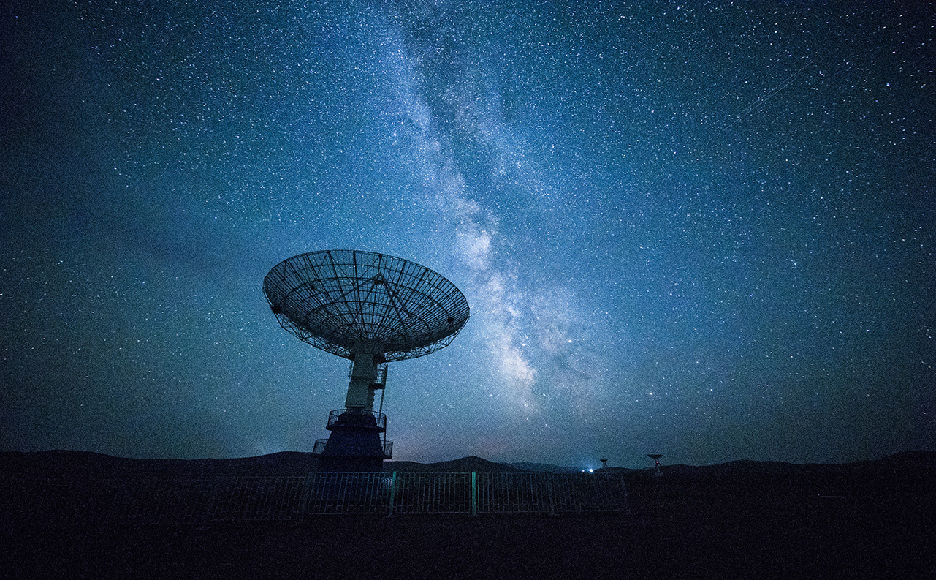
DEVDEST PROGRAMMERS’ APPLICATION
Discuss
Design
Develop

Slide 19

Thank You!
Team semicolon
1706036 Devansh Kashyap
1706038 Harsh Singh
1706040 Himanshu

